Slide 1
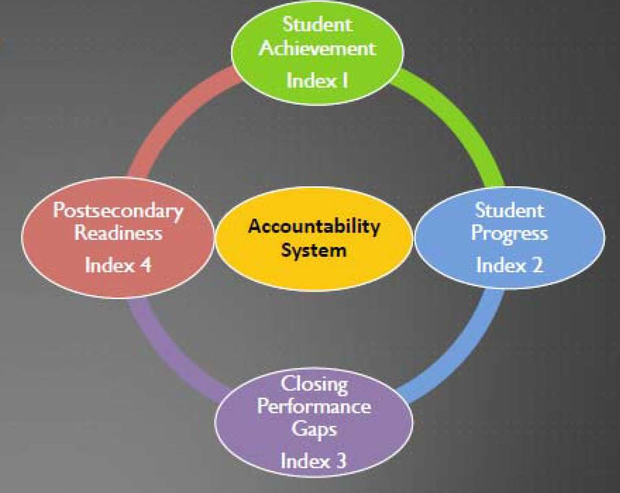
Index Accountability 2014
Created by Accountability and Compliance staff of Region 17 Education Service Center

Slide 2
Performance Index Framework
To receive a
Met Standard rating, all campuses and districts must meet the performance targets for all four indexes for which they have performance data in 2014.
Student Achievement
Index I
Postsecondary Readiness
Index 4
Accountability System
Student Progress
Index 2
Closing Performance Gaps
Index 3

Slide 3
Benefits of an Index System
Eliminates the “death by single cell” of all previous systems in Texas.
Allows areas of strength to offset areas of that perhaps need improvement.
Gives districts and campuses a comprehensive data system to improve instruction.

Slide 4
Drivers
All Accountability Systems have drivers that come from legislation. (HB3 from the 82nd legislative session and HB5 from the 83rd legislative session.)
College Readiness is primary driver of this system.
Student growth is being used for first time in this system
Level III (top end) performance of students who are economically disadvantaged or have historically underperformed. This is also know as “Closing the Achievement Gap” in this system.

Slide 5
Index Targets for 2014
 | Index 1 | Index 2 | Index 3 | Index 4
 |  |  |  | All 4 components | STAAR only
District | 55 | 16 | 28 | 57 | 13
Campus:
Elementary | 55 | 33 | 28 | N/A | 12
Middle School |  | 28 | 27 | N/A | 13
High School/K-12 |  | N/A | 31 | 57 | 21
Districts and campuses must meet ALL index targets on which they are evaluated to receive a “Met Standard” rating.

Slide 7
Index 1: Student Achievement 2014 Target: 55
Index 1: Student Achievement provides an overview of student performance based on satisfactory student achievement across all subjects for all students on BOTH general and alternative assessments.
This index is purely pass or fail based on the passing standard (Phase-In 1 for 2014).
It takes all STAAR assessments and calculates by content area.
Here is an example.
Notes:
Page 19, 30 Index 1: Student Achievement measures campus and district performance based on satisfactory student achievement combined over all subjects for all students.

Slide 8
Index Targets for 2014
 | State Index I Target | District and Campus Score
District | 55
Campus:
Elementary | 55
Middle School
High School/K-12
Districts and campuses must meet ALL index targets on which they are evaluated to receive a “Met Standard” rating.

Slide 9
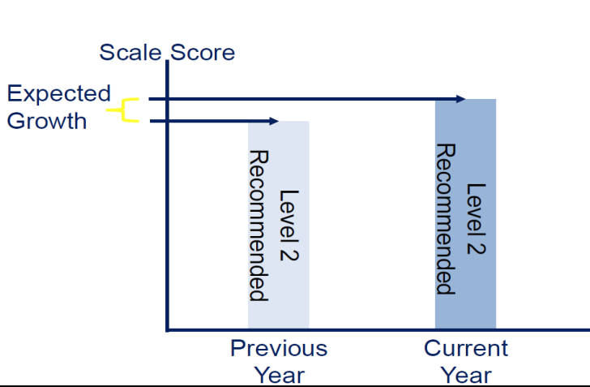
Index 2: Student Progress 2014 Target: District Target is 16
Index 2: Student Progress focuses on actual student growth independent of overall achievement levels for each race/ethnicity student group, students served by special education, and English language learners.
This index measures student progress over time in Reading and Math.
Points are given if students meets the STAAR Progress Measure based on how much better they got from previous school year STAAR assessment.
One additional point is given if they exceed the growth expectation.
High Schools do not have this Index this school year.
Notes:
ELLs?????

Slide 10
Index Targets for 2014
 | State Targets for Index 2 | District and Campus Index 2 Results
District | 16
Campus:
Elementary | 33
Middle School | 28
High School/K-12 | N/A | N/A
Districts and campuses must meet ALL index targets on which they are evaluated to receive a “Met Standard” rating.

Slide 11
Index 3: Closing Performance Gaps 2014 Target: District Target is 28
Index 3: Closing Performance Gaps emphasizes advanced academic achievement of the economically disadvantaged student group and the lowest performing race/ethnicity student groups at each campus and district.
This index measures each subject area’ economically disadvantaged students and two lowest performing race/ethnicity groups from previous school year.
One point is given for each student who passes and an extra point is given for each student who meets the Level III (the very top) passing standard.
Repeat for Math, Writing, Science and Social Studies

Slide 12
Index Targets for 2014
 | State Index 3 Targets | District and Campus Index 3 Results
District | 28
Campus:
Elementary | 33
Middle School | 28
High School/K-12 | 31
Districts and campuses must meet ALL index targets on which they are evaluated to receive a “Met Standard” rating.

Slide 13
Index 4: Postsecondary Readiness District Target: 57
Index 4: Postsecondary Readiness emphasizes the importance of earning a high school diploma that provides students with the foundation necessary for success in college, the workforce, job training programs, or the military; and the role of elementary and middle schools in preparing students for high school.
Index 4 uses four different indicators that are 25% of the total score each.
STAAR Final Level II,
Graduation Score/Rate,
Graduation Plan, and
College-Ready Graduates are not available for high schools or districts, evaluate only the STAAR Final Level II performance at the following Index 4 targets:
High Schools/K-12: 21
Districts: 13
Index 4 for Elementary and Middle School Campuses only use the STAAR Percent Met Final Level ll on two or more tests for (eight student groups) only.
Notes:
Use new definition from 2014 manual

Slide 14
Index 4: Postsecondary Readiness
Indicator | All Students | African Amer. | Amer. Indian | Asian | Hispanic | Pacific Islander | White | Two or More Races | ELL | Special Ed. | Total Points | Max. Points
STAAR Score
STAAR % Met Final Level ll on Two or More Tests | 29% | 16% |  | 40% | 23% |  | 38% | 36% |  |  | 182 | 600
STAAR Score (STAAR total points divided by maximum points) |  |  |  |  |  |  |  |  |  |  | 30
Graduation Score (Gr. 9-12)
4-yr. graduation rate | 84.3% | 78.8% |  |  | 78.8% |  | 91.6% | 86.0% | 44.2% | 69.8% | 533.5 | 700
5-yr. graduation rate | 85.1% | 78.8% |  |  | 80.0% |  | 92.1% | 84.0% | 48.9% | 77.5% | 546.4 | 700
Highest Graduation Total |  |  |  |  |  |  |  |  |  |  | 546.4 | 700
Graduation Score (best of total graduation points divided by maximum points) |  |  |  |  |  |  |  |  |  |  | 78.0
RHSP/DAP Score
4-yr. graduation Percent RHSP/DAP | 82.7% | 76.4% |  |  | 83.6% |  | 83.0% |  |  |  | 325.7 | 400
RHSP/DAP Score (best of total RHSP/DAP points divided by maximum points) |  |  |  |  |  |  |  |  |  |  | 81.4
Postsecondary/College-Ready Graduates Score
College-Ready Graduates either subject (ELA or Math) | 82.0% | 72.0% |  |  | 78.0% |  | 89.0% |  |  |  | 321.0 | 400
College-Ready Score (total points divided by maximum points) |  |  |  |  |  |  |  |  |  |  | 80.2
Overall Index Score
STAAR Score | 30.0 | Multiply by Weight
Graduation Score | 78.0
RHSP/DAP Score | 81.4
College-Ready Score | 80.2
Index Score (sum of weighted index scores)
Notes:
This slide or slide 42?

Slide 15
Index Targets for 2014
 | Index 4 State Targets |  | Index 4 District and Campus Targets
 | All 4 components | STAAR only | All 4 components | STAAR only
District | 57 | N/A |  | N/A
Campus:
Elementary | N/A | 12 | N/A
Middle School | N/A | 13 | N/A
High School/K-12 | 57 | 21
Districts and campuses must meet ALL index targets on which they are evaluated to receive a “Met Standard” rating.

Slide 16
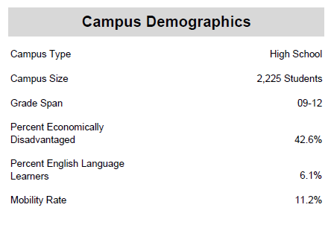
2014 Distinction Designations
Per Texas Education Code (TEC) §39.201, alternative education campuses (AECs) evaluated under AEA provisions are not eligible for distinction designations.
Comparison Groups are determined by common campus demographics.

Slide 17
2014 Distinction Designations
Student Progress (based on Index 2)
Closing Performance Gaps (based on Index 3)
Academic Achievement in:
Reading/English Language Arts
Mathematics
Science
Social Studies
Postsecondary Readiness for campuses and districts

Slide 18
2014 Distinction Designations
Districts and Campuses Postsecondary Readiness:
House Bill 5 (83rd Texas Legislature, 2013) expanded distinction designations to both districts and campuses for outstanding performance in attainment of postsecondary readiness.
Index 4 STAAR Component: Percent of Students at Final Level II Performance Standard
Four-Year Graduation Rate (Class of 2013 longitudinal cohort) Recommended High School Program or
Distinguished Achievement Program (RHSP/DAP) Rates (Class of 2013 longitudinal cohort)
College-Ready Graduates (school year 2012-13 graduates meeting the Texas Success Initiative (TSI) college readiness standards in both reading/ELA and mathematics based on TAKS, SAT, or ACT)
Advanced/Dual Enrollment Course Completion Rate (school year 2012-13)
SAT/ACT Performance (At/Above Criterion, 2012-13)
SAT/ACT Participation (2012-13)
AP/IB Examination Performance: Any Subject (school year 2012-13percent of examinees meeting the criterion score)
Notes:
Is this the latest? Do we need to list these?

Slide 20
Distinction Designations Index 2 & Index 3

